Slide 1

Capstone #3 KKBox Customer Lifetime Value Analysis
DANIEL JURADO

Slide 2
“No one ever says: Man... he was a lousy lawyer, but at least he was cheap!!"
- Peter fader

Slide 3
1 — Churn = Happiness: How To Keep Customers Happy with Analytics
1) Which Customers Have the Highest Probability of Churning Soon?
2) What is the Lifetime Value for Each of Our Customers?
3) What Retention Offer Leads to a Positive Response from that Customer?

Slide 4
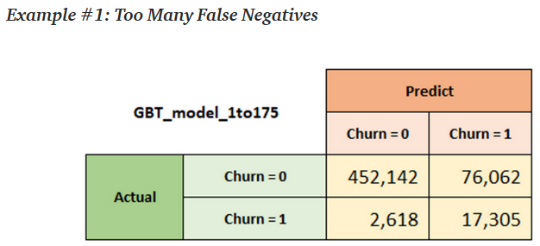
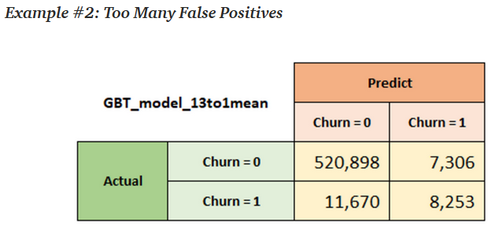
Which Customers Have the Highest Probability of Churning Soon?
Trade-offs… Which to choose?

Slide 5
So, Which one do we choose?
… Enter Customer Lifetime Value

Slide 6
Customer Lifetime Value - LTV
- Value of Acquisition and Retention
- Defined as the present value of the future (net) cash flows.
- This is a forward-looking concept and is not a measure of past profitability.
Additionally, it also gives us the invaluable ability to identify which channels are producing our most valuable customers (via attribution) through its calculation.

Slide 7
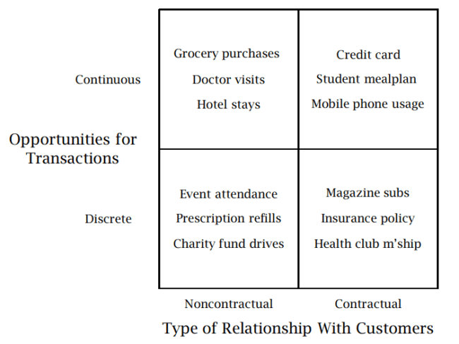
How do we calculate LTV?
All revenue streams can be boiled down to either a Contractual or Non-Contractual model.
In a contractual setting, we observe the time when our customers “die”.
In a non-contractual setting, the time in which a customer becomes inactive is not observed

Slide 8
Let's get started.
In this project we will dive into its calculation and discuss its implications for our business.
Discrete Contractual Setting Calculation:
Survival Analysis - EDA Technique
Cox’s Proportional Hazard Regression – Non-Parametic Model → Expected Lifetime
Lifetime Value = Expected Lifetime * Discrete Revenue per Time (Days, Months..)

Slide 9
Survival Analysis
Answers: “How long would it be, before a particular event occurs?’
We refer to this a ‘time to event’ analysis.
More of an EDA-technique to evaluate the expected lifetime of different cohort groups.

Slide 10
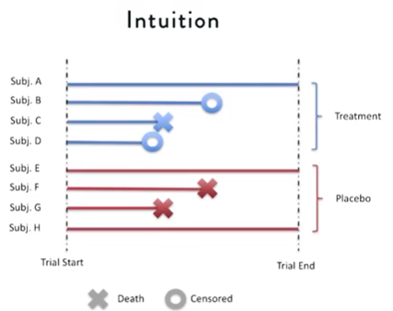
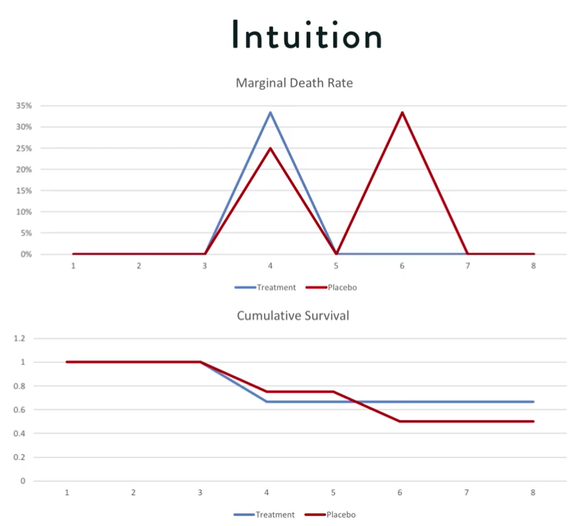
Survival Analysis

Slide 11
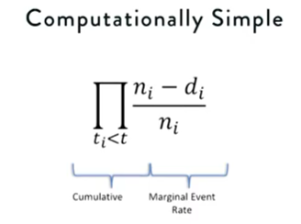
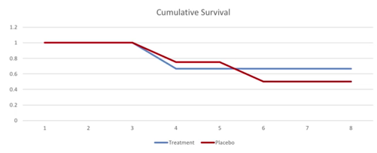
Survival Analysis
Aka Survivor Function

Slide 12
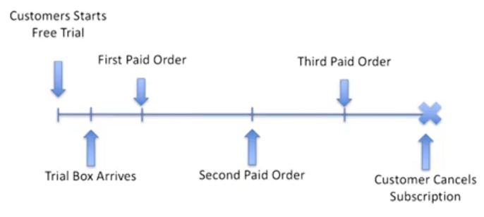
How does this relate to KKBox Subscriptions?

Slide 13
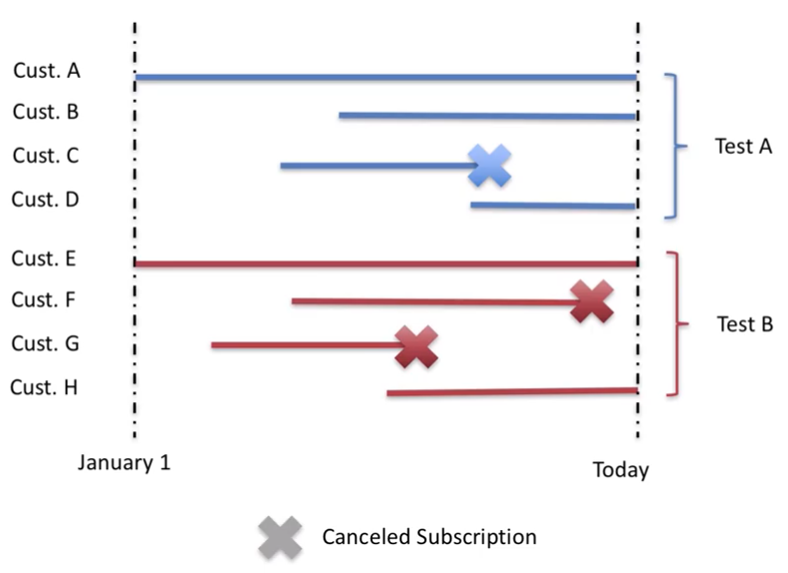
How does this relate to KKBox Subscriptions?

Slide 14
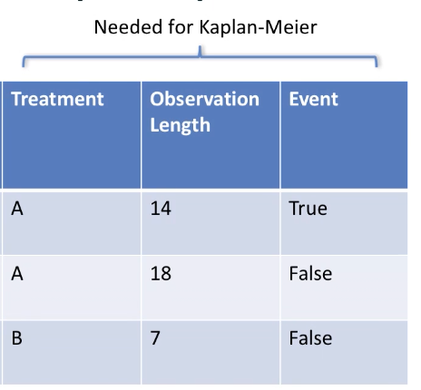
Metrics Needed To Calculate

Slide 15
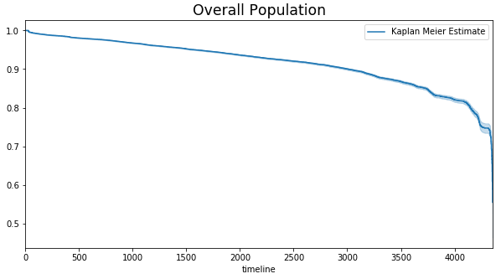
Kaplan-Meier Curve Overall Population
Shows what the probability of an event is at a certain time interval.
Overall retention seems pretty strong with ~78% probability of retaining users past 4000 days.
KKBox seems to be quite a healthy business.

Slide 16
Kaplan-Meier Curve Assumptions when creating cohorts
Variables do not and cannot change over time.
We cannot use any of our trend features.
We will evaluate:
- Cluster (not so legal)
- Registration Method
- Number of Unique Payment Plans

Slide 17
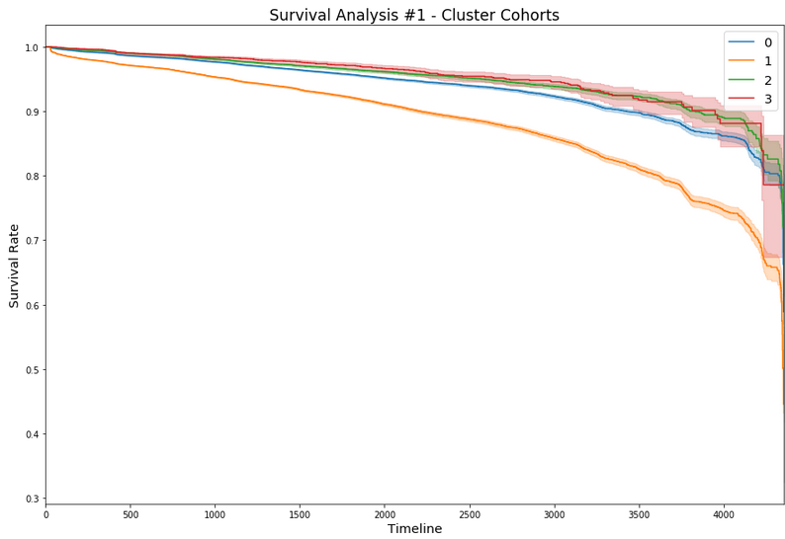
Kaplan-Meier Curve Survival Analysis #1 – Cluster Cohorts

Slide 18
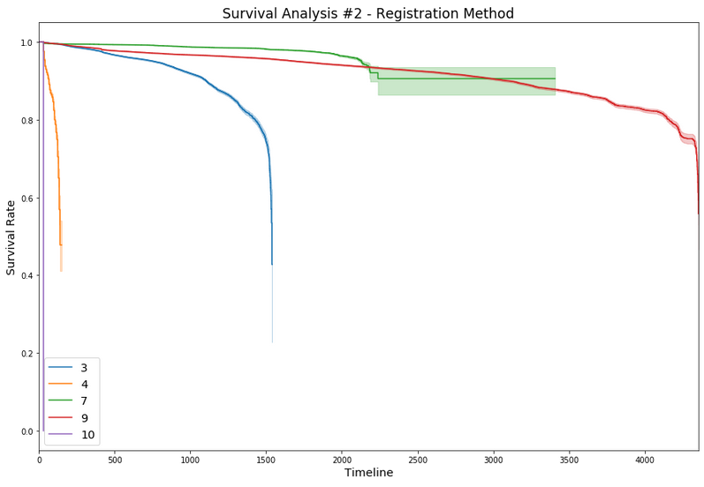
Kaplan-Meier Curve Survival Analysis #2 – Registration Method

Slide 19
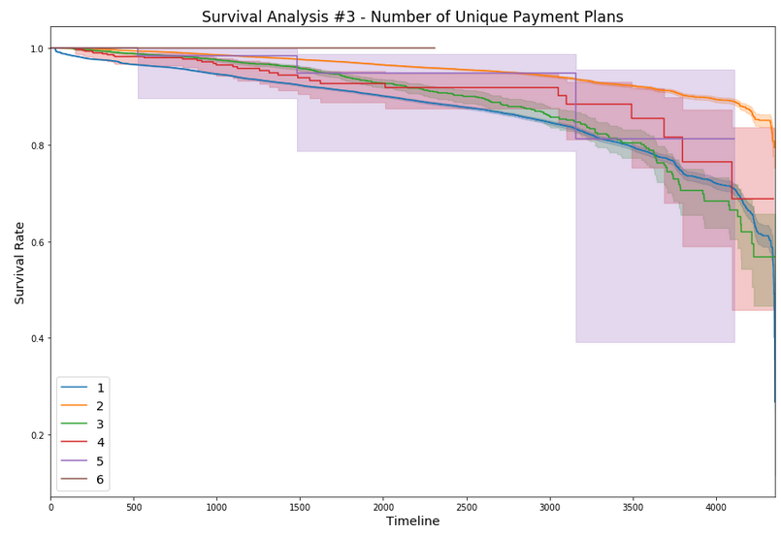
Kaplan-Meier Curve Survival Analysis #3 – Number of Unique Plans

Slide 20
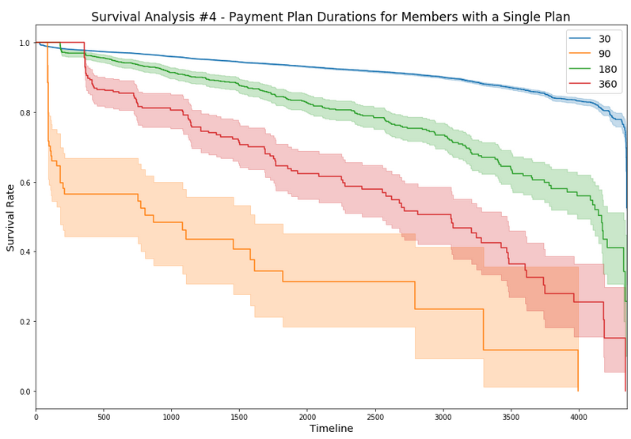
Kaplan-Meier Curve Survival Analysis #4 – Single Plan Users

Slide 21
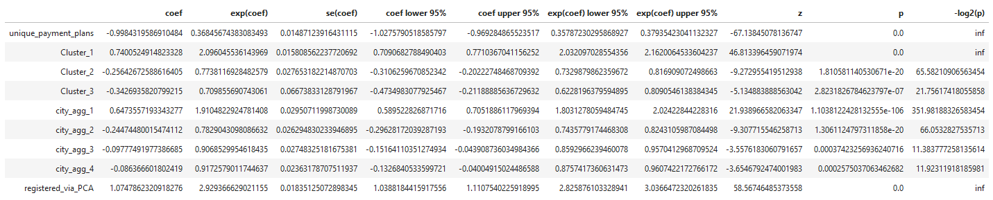
Cox Proportional Hazard Model (Survival Regression)
Model used for investigating the relationship between the survival time and one or more variables (includes categorical and quantitative predictors).
Terminology
‘Hazard rate’ is the rate at which an event (like death, failure, etc.) happens at a time t

Slide 22
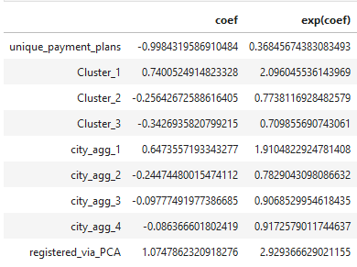

Cox Proportional Hazard Model (Survival Regression)
‘Hazard rate’ Interpretation
Now that we have our model we can calculate Expected Lifetime for each user.

Slide 23
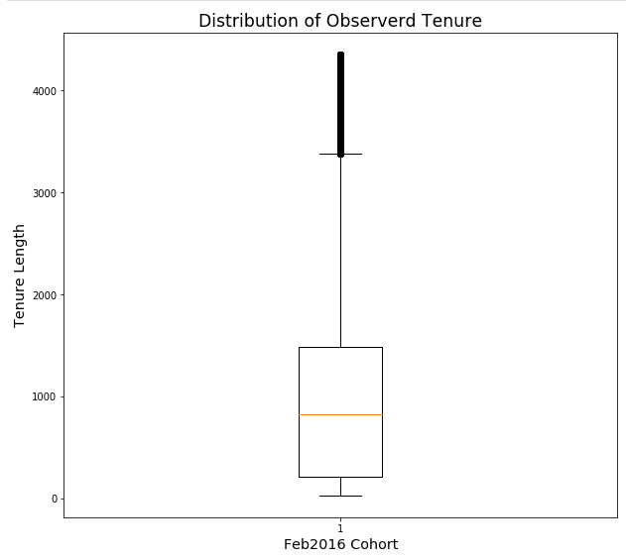
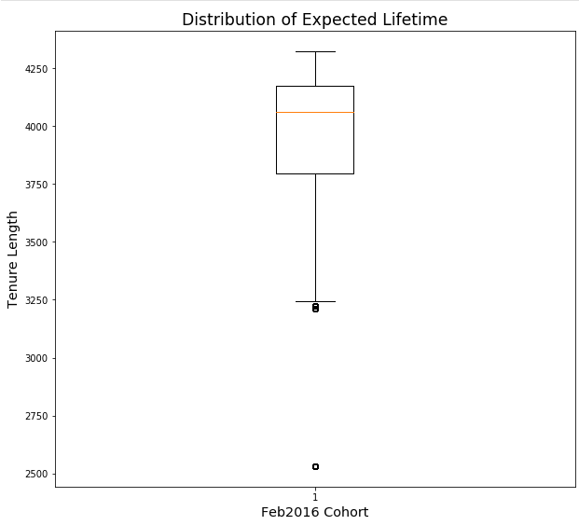
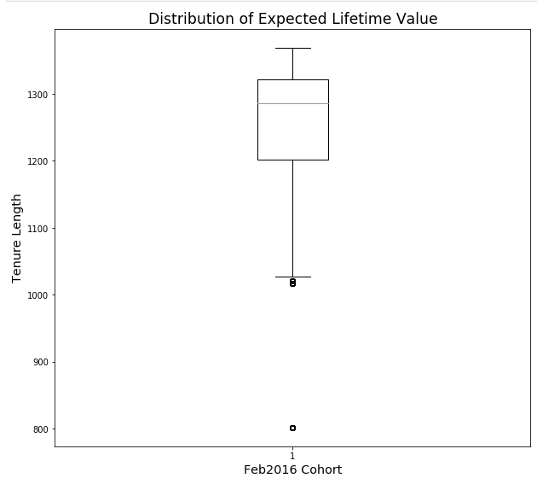
Tenure, Lifetime, and LTV

Slide 24
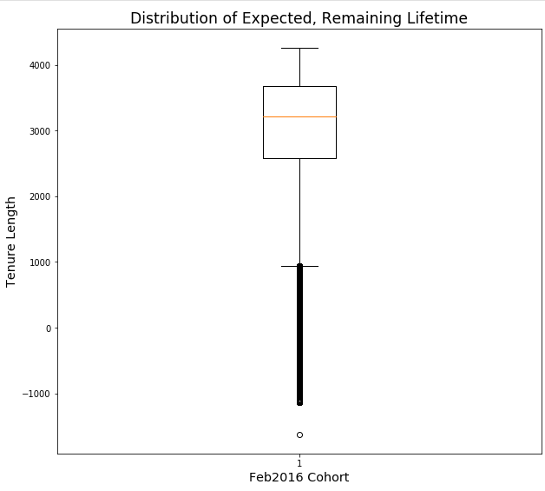

Remaining Lifetime and LTV

Slide 25
Information about our members
What Is The Complete LTV Value For Current Member Population?
$692,313,445.43
What Is The Complete Remaining LTV Value Of Each Cohort?
$518,879,414.64
LT For Each User?
Mean: 3,998 Days
Median: 4,060 Days
LTV For Each User?
Mean: $1263.06
Median: $1,285.78

Slide 26
Conclusion #1: What can we do with this Info?
Acquisition Strategies
Activation Strategies

Slide 27
Conclusion #1: What can we do with this Info?
Cost of Acquisition vs Value of Acquisition
“No one ever says: Man... he was a lousy lawyer, but at least he was cheap!!“ – Pete Fader
The Floor vs The Ceiling Mentality

Slide 28
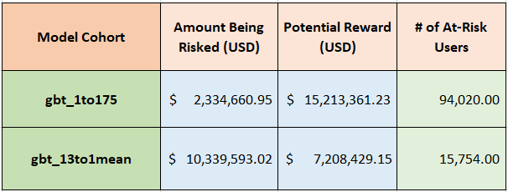
Which Customers Have the Highest Probability of Churning Soon?
Trade-offs… Which to choose?

Slide 29
Let’s play with some treatments

Slide 30
1-Month Free Subscription as Treatment
Assumptions:
Treatment cost is 9.50 Dollars (1 Month Subscription)
We will only approach users with where we can get a gross return of at least 200%.
All members receive the same treatment

Slide 31
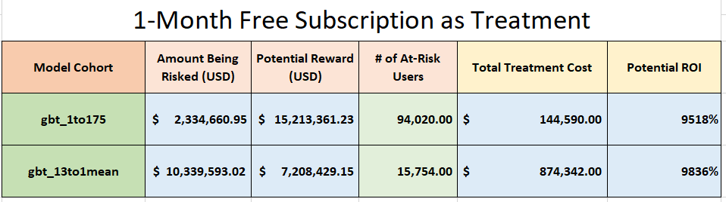
1-Month Free Subscription as Treatment

Slide 32
3-Month Free Subscription as Treatment
Assumptions:
Treatment cost is 28.5 Dollars (3 Month Subscription)
We will only approach users with an LTV equal to thrice the amount of the treatment as we are interested in only getting a gross return of atleast 200%.
Potential Reward is Total LTV Remaining for all users
All members receive the same treatment

Slide 33
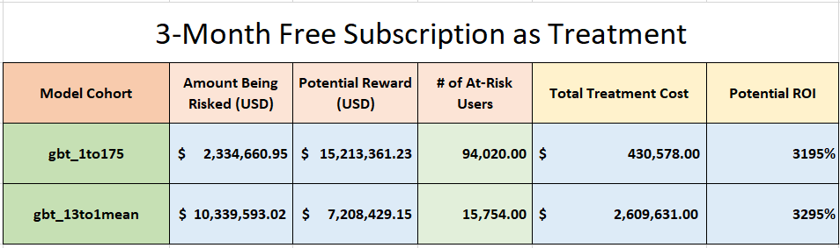
3-Month Free Subscription as Treatment

Slide 35
1 — Churn = Happiness: How To Keep Customers Happy with Analytics
1) Which Customers Have the Highest Probability of Churning Soon?
2) What is the Lifetime Value for Each of Our Customers?
3) What Retention Offer Leads to a Positive Response from that Customer?

